Slide 1

Level 4-5 Group 17
Ross warren
Razvan
Darren wright

Slide 2
Tagline

Slide 3
brief
Use two words from the dictionary of obscure sorrows to emotively engage the player and understand how emotions are generated.

Slide 4
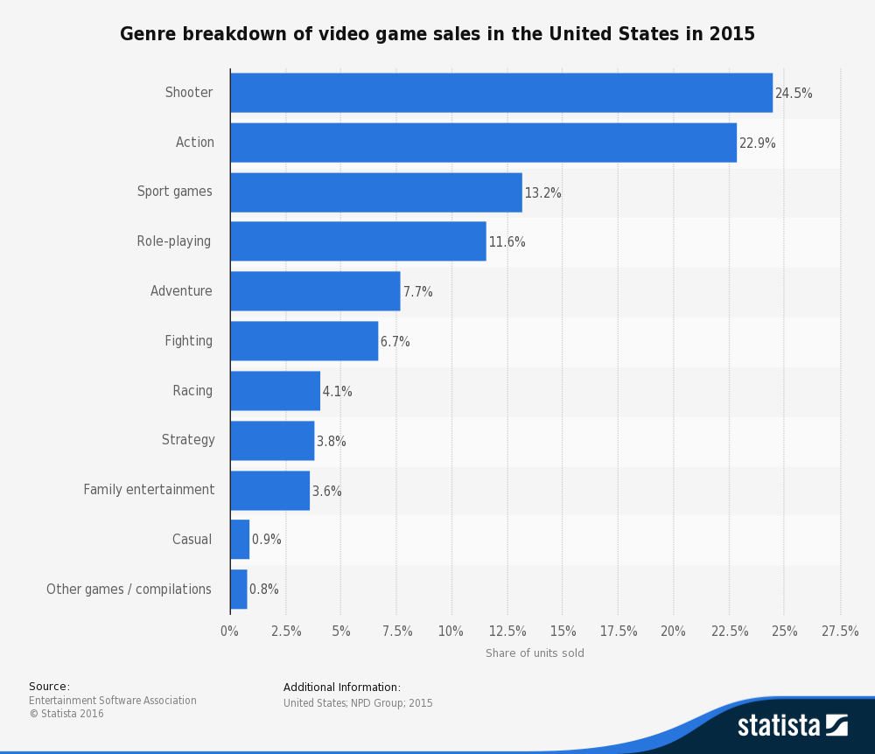
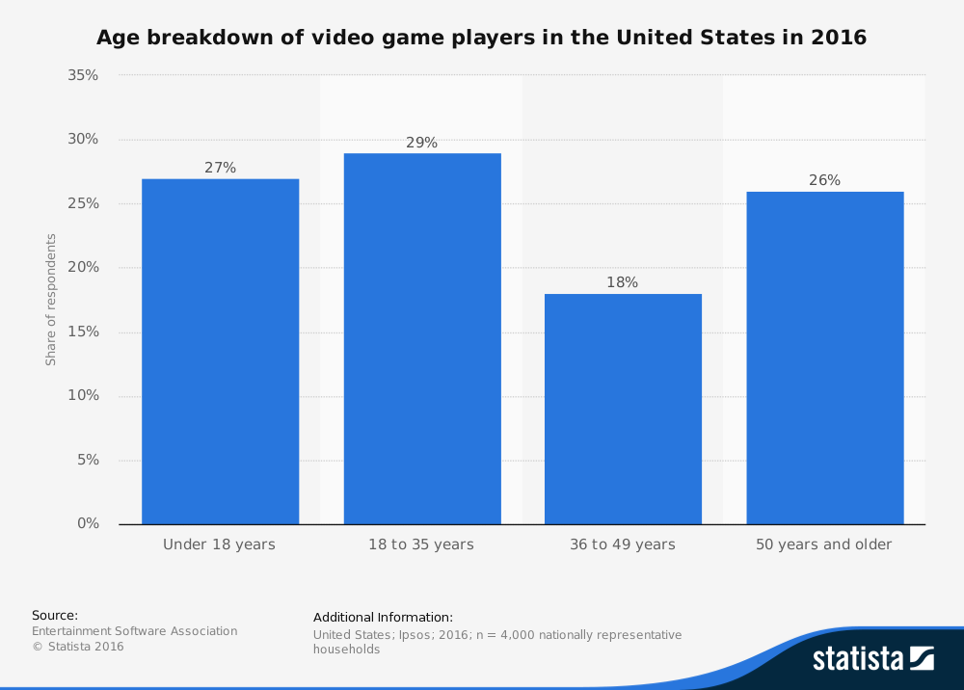
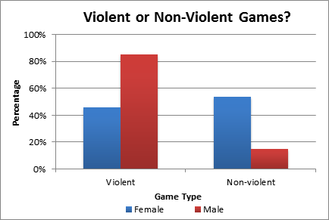
Target Demographic

Slide 5
emotions
The emotions we have chosen is Onism and Rukkenrunruhe.
Frustration
Confinement
Regret
Memories of happiness

Slide 6
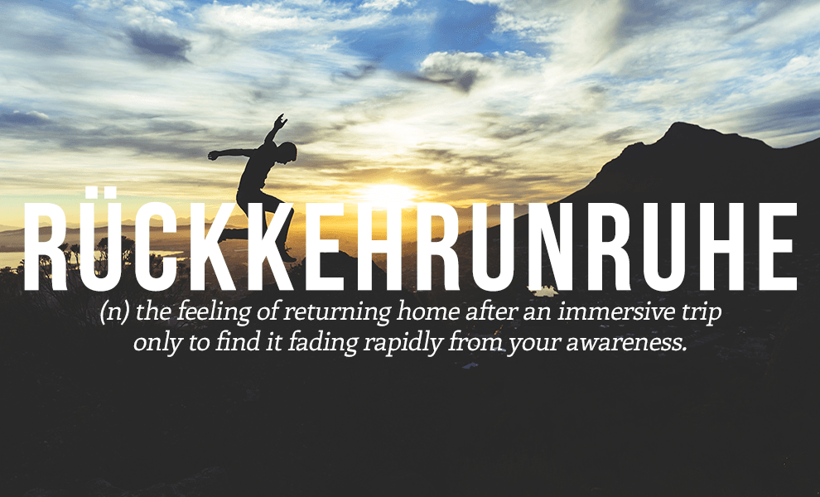
Rukkenrunruhe.
The emotions we have chosen is Onism and Rukkenrunruhe.
Frustration
Regret
Memories of happiness
Dream state

Slide 7
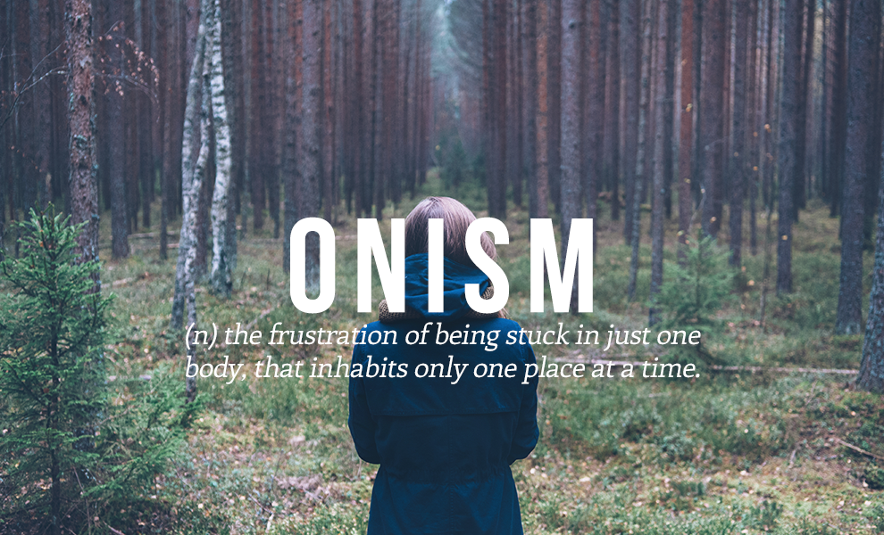
Onism.

Slide 8

Game theme.

Slide 9
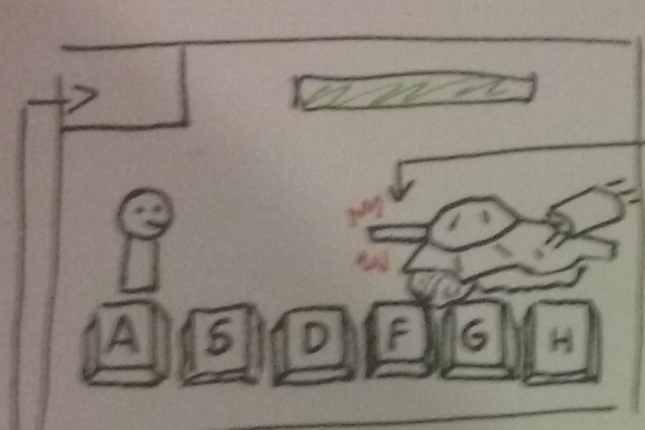
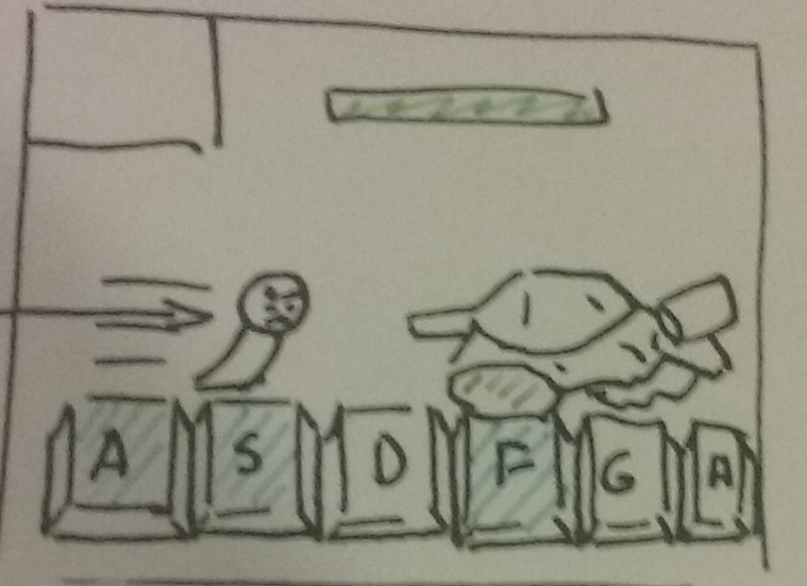
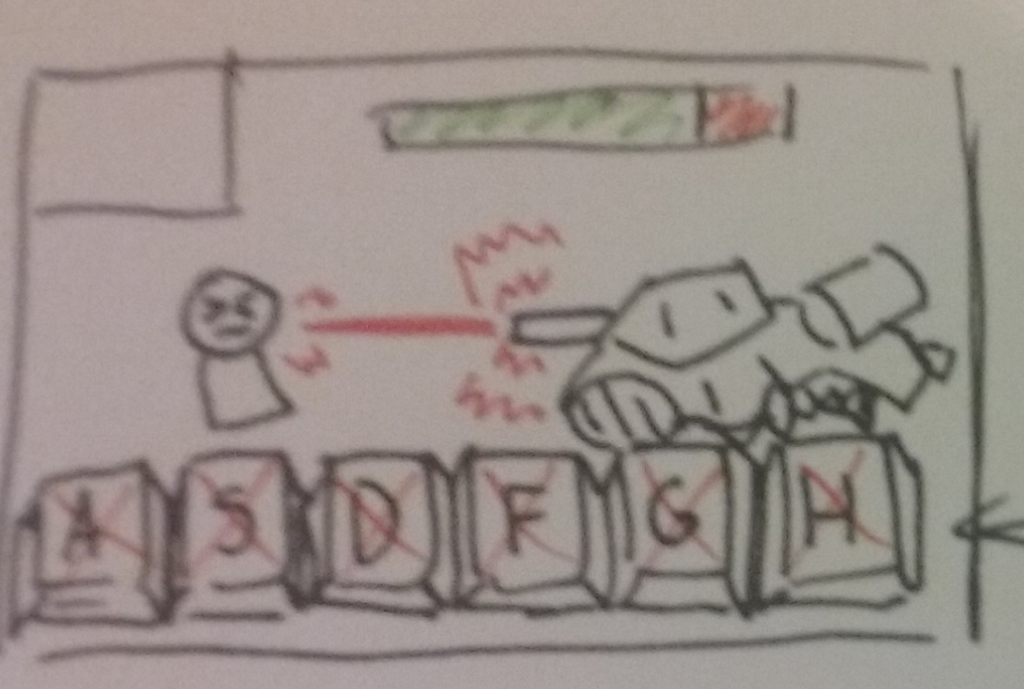
Mechanics; Quick time combat.
Iconography of a visual timer that the enemy is going to attack, this is the light emanating the barrel getting bigger.
This shows the buttons that will be displayed for the quick time mechanic. They will flash a colour in order of which ones to press first.
When the command is entered incorrectly or not fast enough, the keypad is locked down till next attack, and the enemy attacks.
Visual of the other scene to display when the risk is coming and a timer counting down till the scenes will swap.
When the command is executed the player character will attack the enemy.
When hit, the player character health goes down.

Slide 10
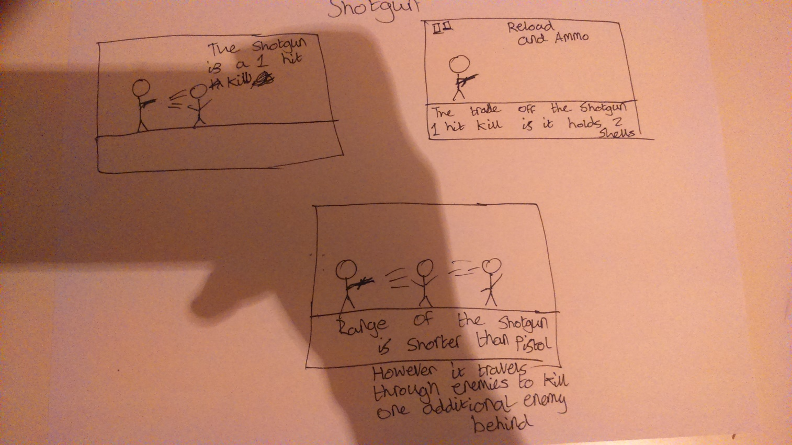
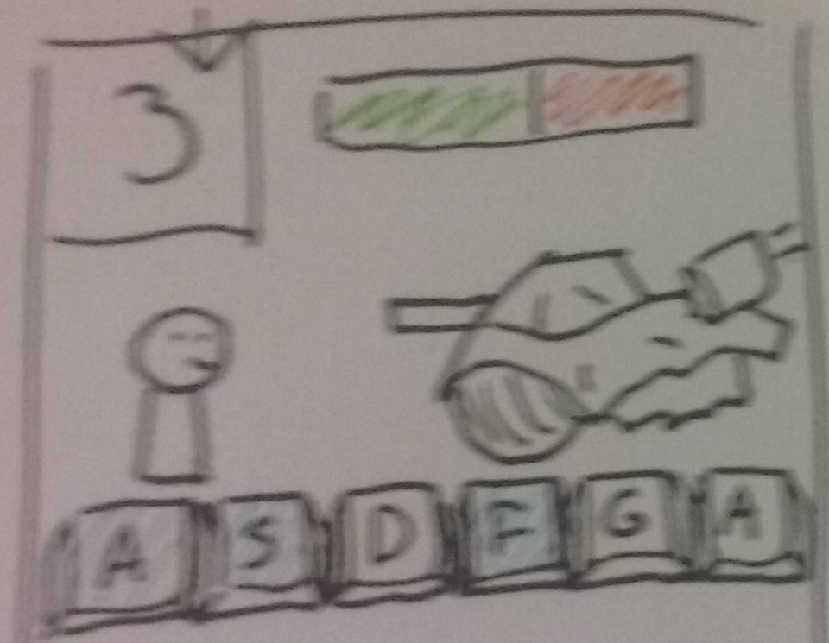
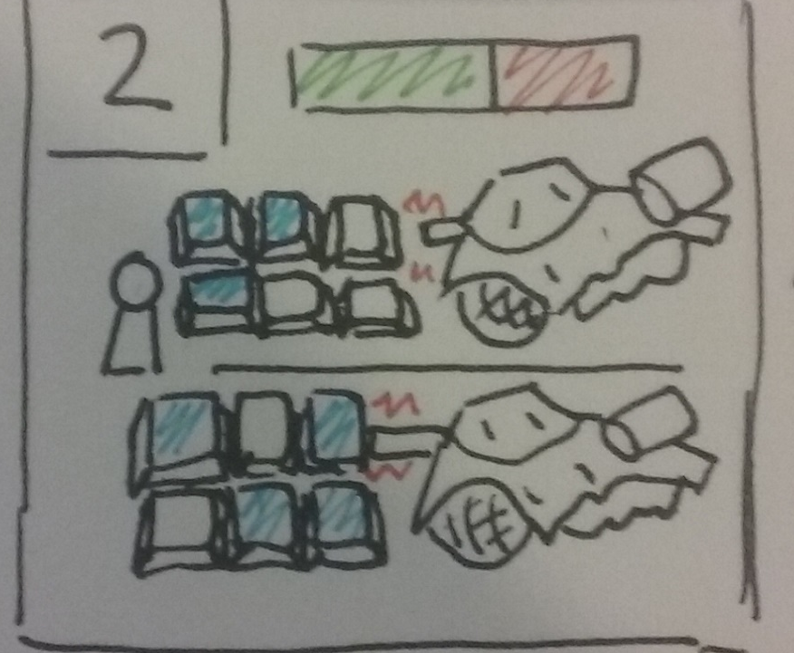
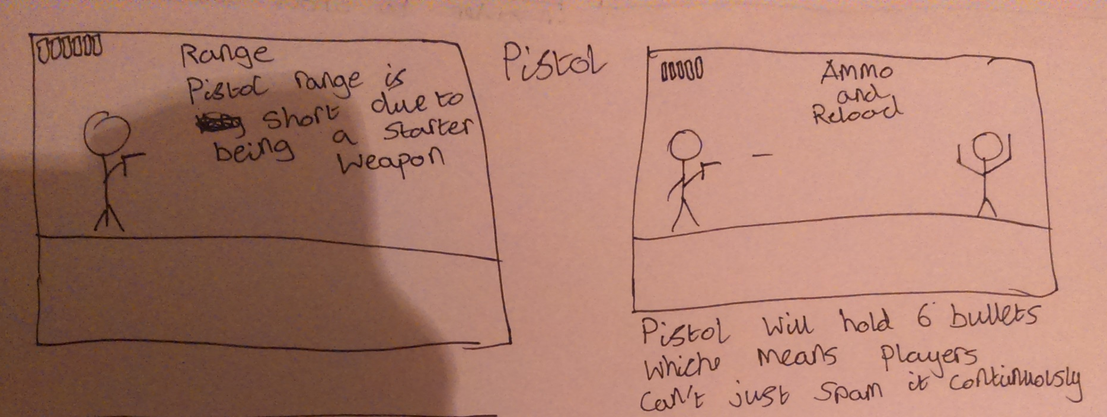
Mechanics; Quick time combat.
Visuals of various shooting combat visuals using various weapons.
Visual timer counting down to when the game changes to the other scene.
Here is an iterating using multiple enemies to increase the challenge of the game.

Slide 11
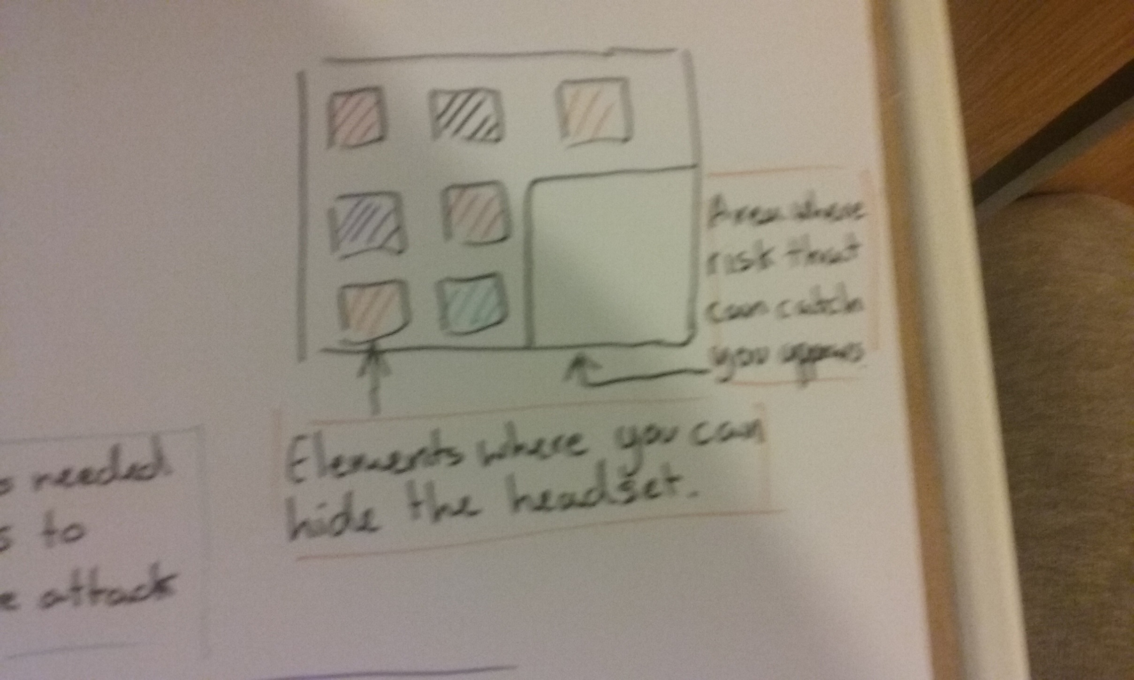
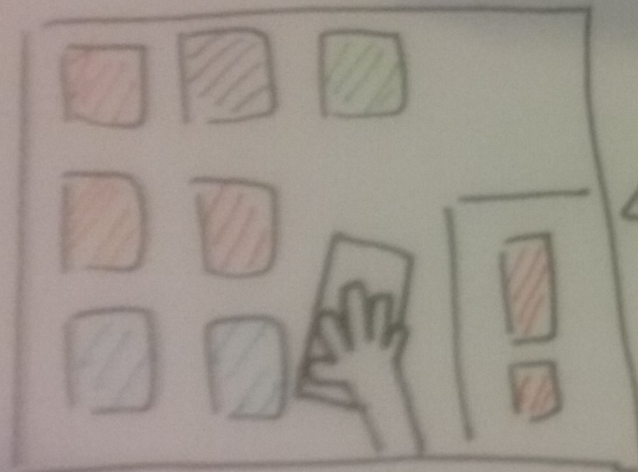
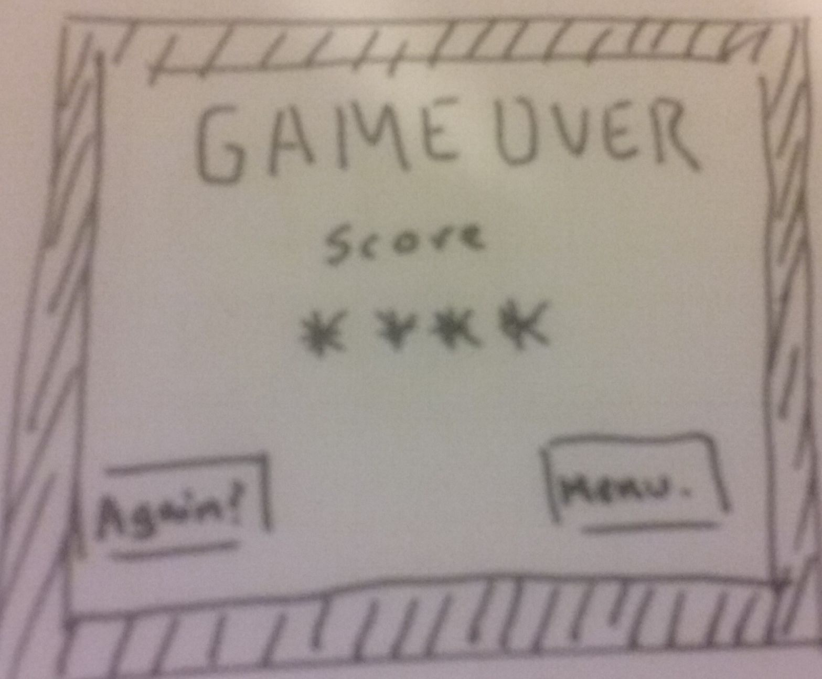
Mechanics; hiding.
Elements of the other scene where you can hide the VR headset from the risk.
Iconography to signify the player being caught hiding the VR headset.
The game over screen depicting the players final score and replay option.
The area in which the risk will appear and can catch your opponent ending the game.

Slide 12
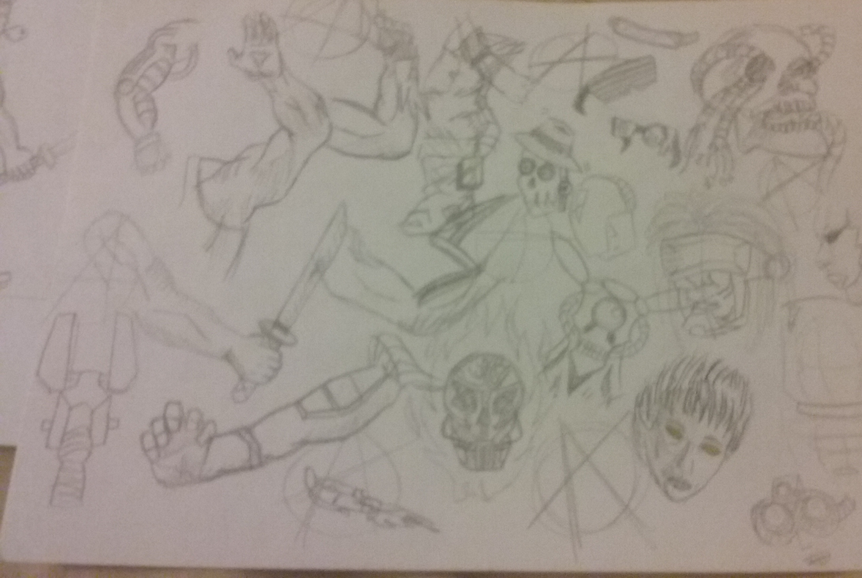
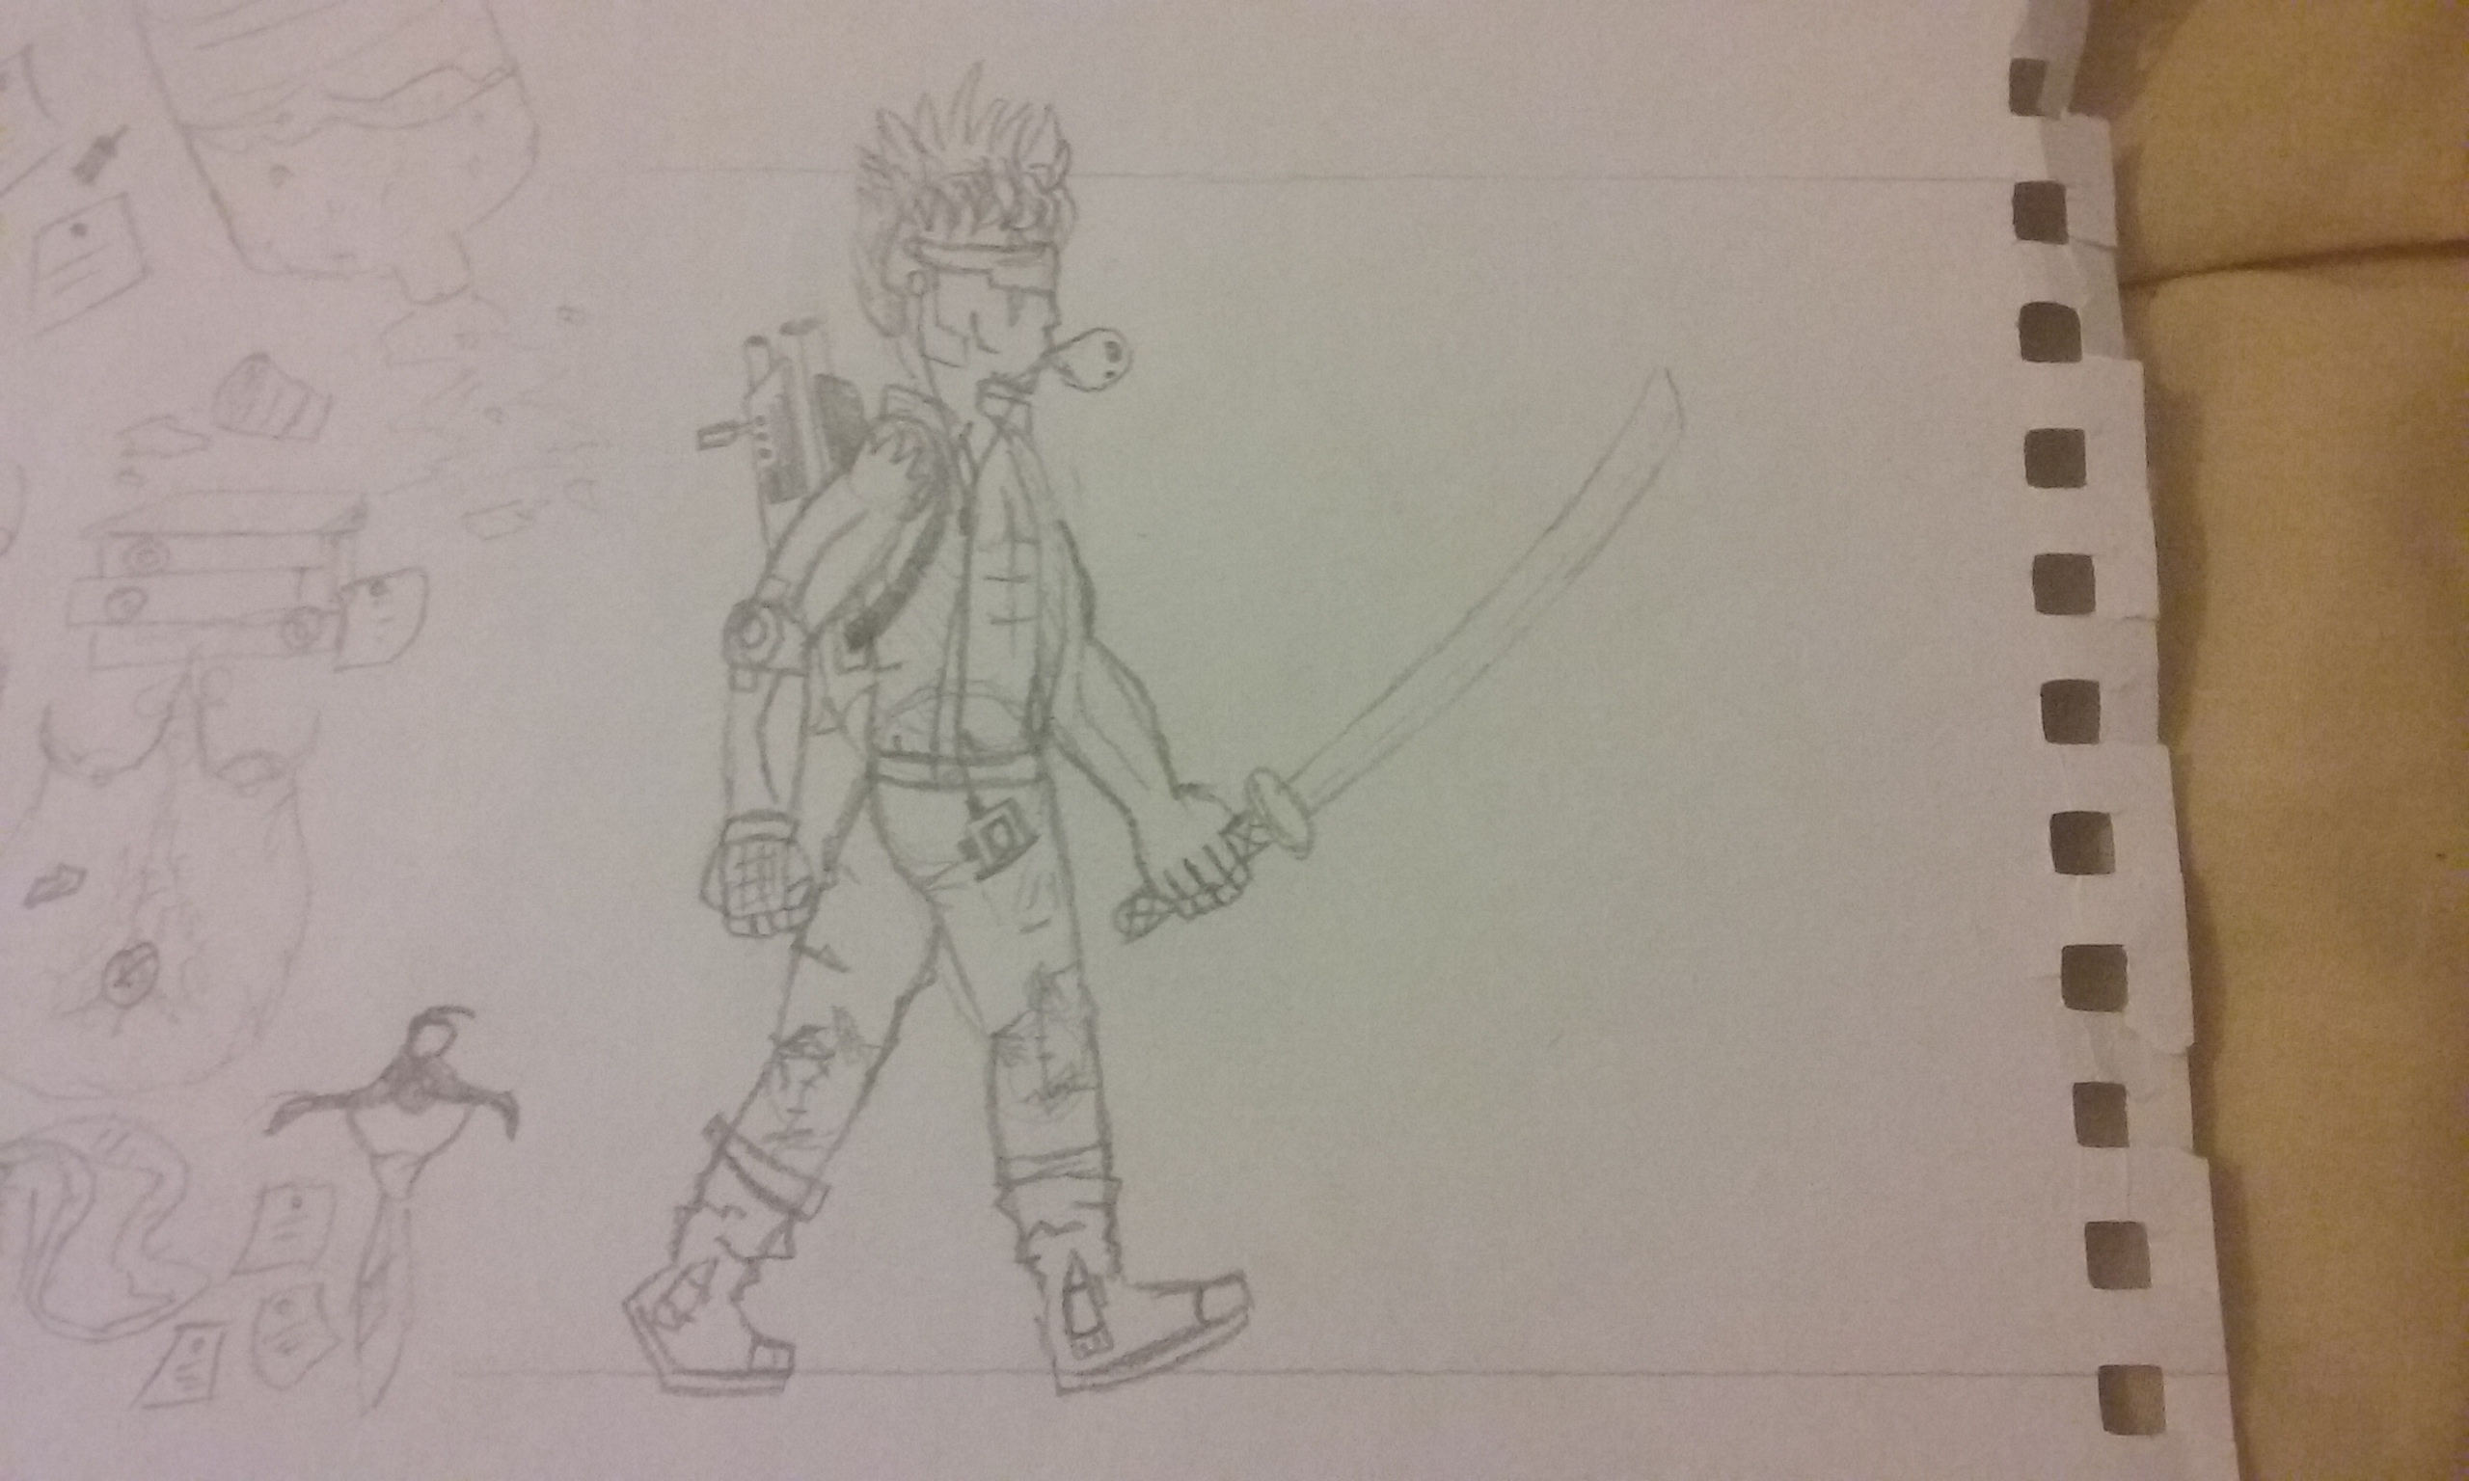
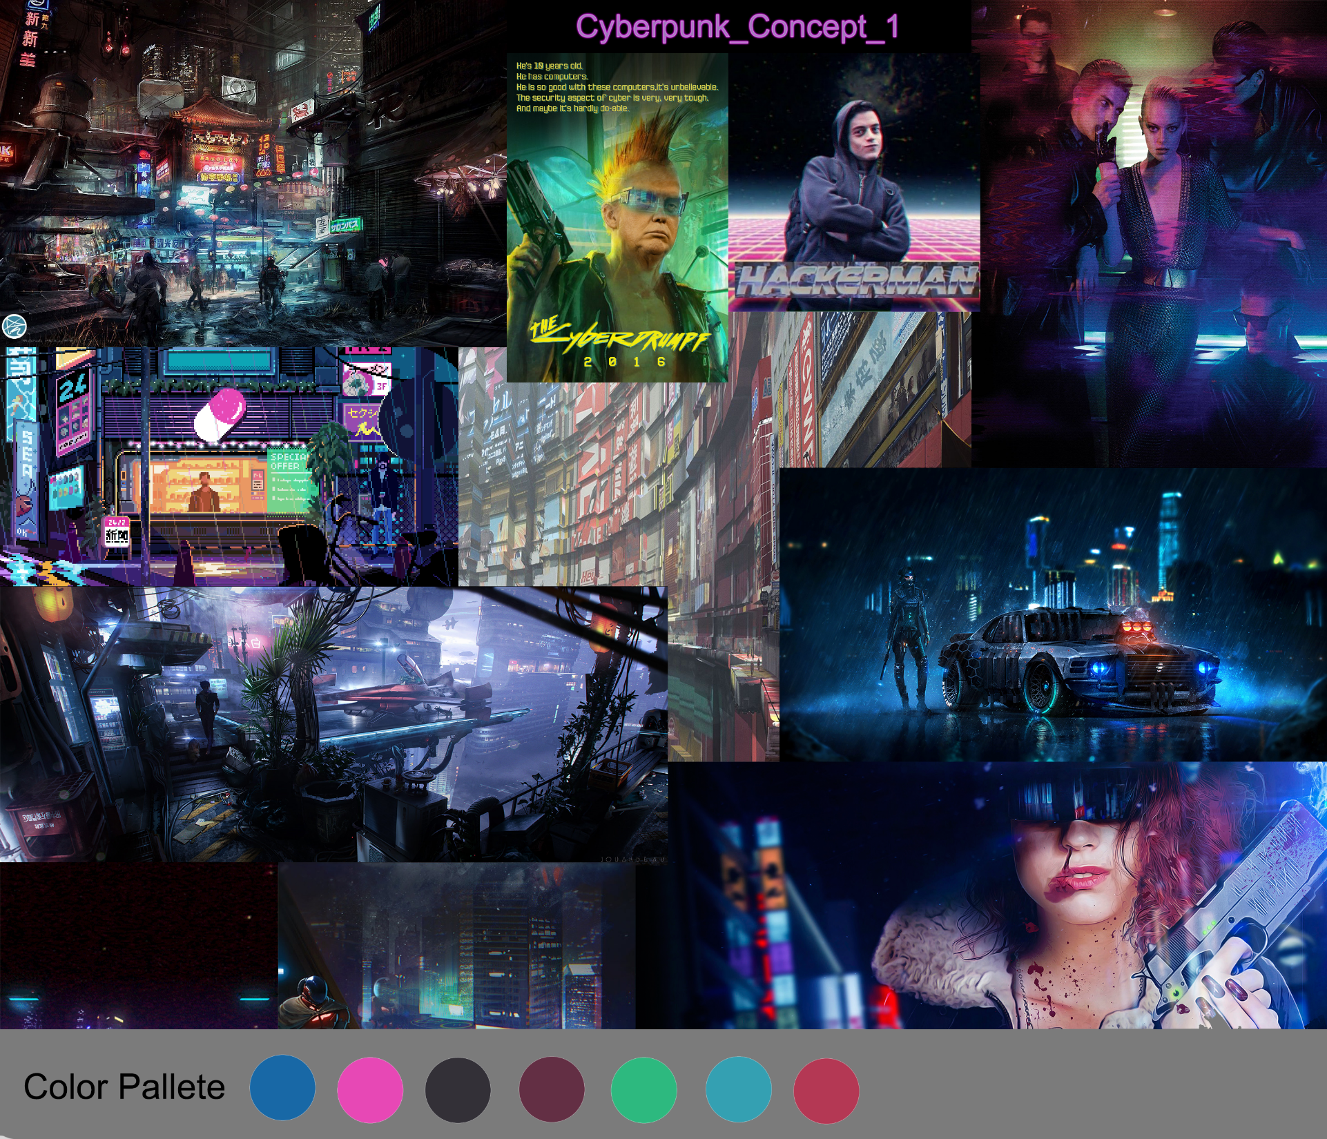
Concept art & MOODBOARDS.

Slide 13
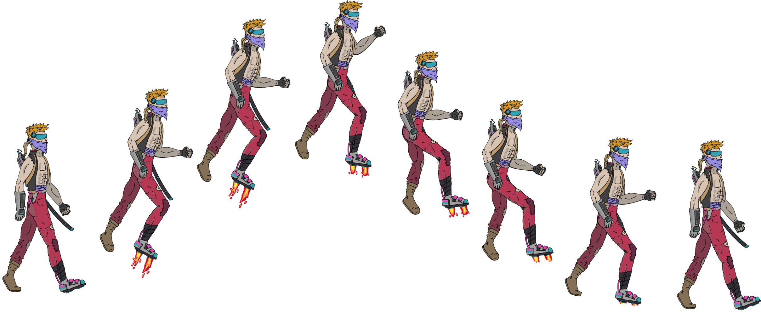
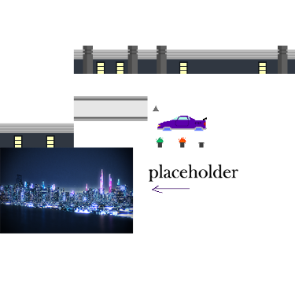


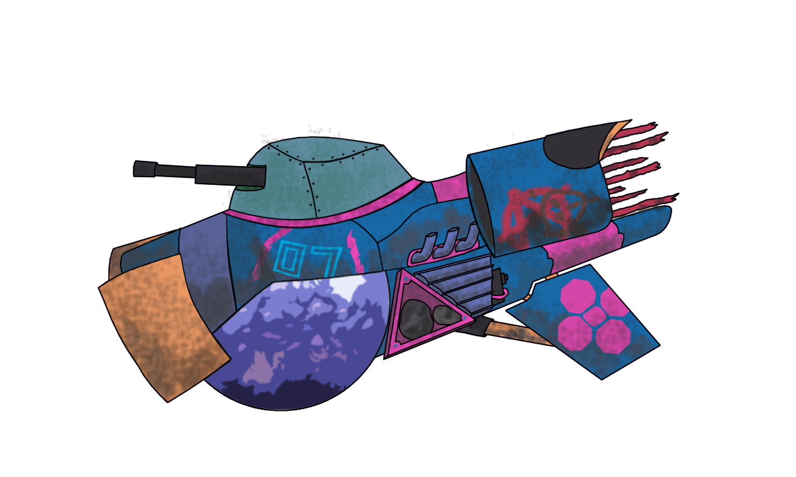
art assets.

Slide 14
Prototype showcase.

Slide 15
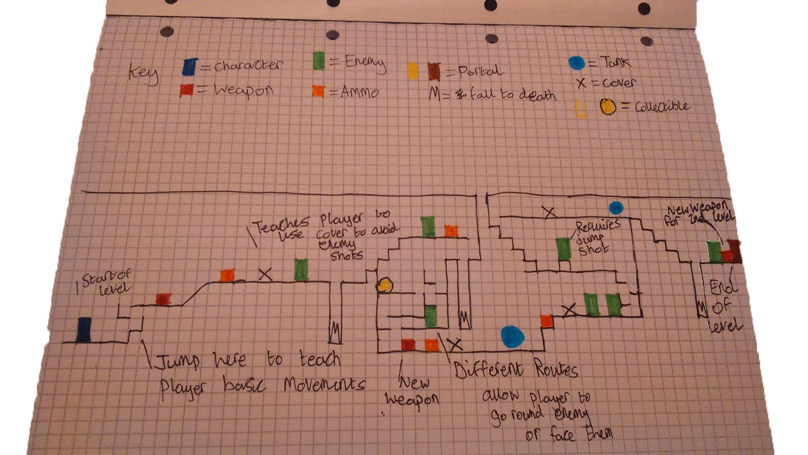
Level design.

Slide 16
Minutes and emails.
The Sprint was closed at 12:00am Tuesday night with all emails counted from the start of the week till then as well;
As you can see although communication was high in this weeks sprint and work was submitted into GitHub, hours were not logged via E-mail as GitHub is currently having issues, resulting in a lack of information on how long the work took.

Slide 17
Questions?

